Slide 1
Presidential Election Simulator
A Exploration of Alternate Election Scenarios - Gary Gregg

Slide 2
U.S. Presidential Elections Are Indirect
The U.S. Constitutional Convention agreed in 1787 on an Electoral College for the purpose of electing the President and the Vice President
Each state is allocated a number of electors in proportion to its population (same as its Congressional representation), plus two (same as its Senate representation)
Electors are reapportioned every ten years based on the results of the most recent census (last, 2010)
48 states use a winner-take-all approach to determine their electors; a candidate who wins a plurality of the popular vote in these states selects a slate of electors pledged to him (or her)
2 states (Maine and Nebraska) assign one elector for a candidate who wins the popular vote in each Congressional districts; two electoral votes then go to a candidate who wins the state at large
To win the Presidency in the Electoral College, a candidate must win a majority of the electoral votes

Slide 3
Why Simulate Elections?
In 1876, 1880, 2000 and 2016 - due primarily to the winner-take-all approach to elector allocation - candidates not receiving at least a plurality of the popular vote became President
In 1876, above, the candidate who received a majority of the popular vote did not become President
In 1824, the candidate who won a plurality of both popular and electoral votes did not become President
More often, the Electoral College magnifies the results of a popular vote win, and does not invert it
This seemingly unfair system is difficult to explain to new students of politics, and to foreign observers
Simulations can show how small and random changes in voting can affect the results of close elections
Slightly changing the voting sentiment in even one key state can affect the results of close elections

Slide 4
Related Work and References
270-to-Win has a 2016 Presidential election simulator at (https://www.270towin.com/2016-simulation/)
270soft.com has a Presidential election game at (https://270soft.com/us-election-games/president-election-game-2016/)
Other election simulators do not seem to offer precise mathematical control over the random selection of state-specific election results
Referencing Introduction to Probability, by Blitzstein and Hwang, I determined that the Beta probability distribution is appropriate for binary election results
A beta distribution can be determined by two parameters, 𝛼 and 𝛽
If 𝛼 and 𝛽 are both greater than one, and equal, the shape of the PDF is a bell curve between 0 and 1

Slide 5
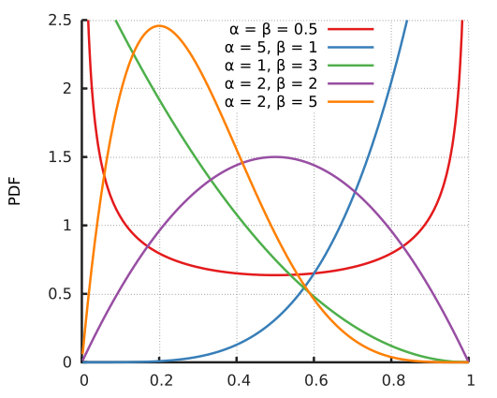
The Beta Distribution

Slide 6
Selecting the Parameters
Beta distributions can also be uniquely determined by a mean, and a variance
The current political alignment of the states has been in place since about 2000
The last twenty years encompass two censuses, and therefore two state elector reapportionments
I chose to simulate any of the last five Presidential elections
For the mean of the beta distribution for each state in each election year, I use the actual election result for that year
For the variance of all beta distributions for each state in each election year, I use the variance of the actual election results in all five elections
Less populated states tend to have greater variance; more populated states have less
Question: Is this a statistically defensible technique? I could not think of anything better

Slide 7
Demo
I had an idea that I would use a tabular format for user modification of distribution means and variances, plus a tabular format for presentation of simulation results showing popular votes and EVs
I also wanted to use a variation of a D3 U.S. map created by Mike Bostick (see https://bl.ocks.org/mbostock/4060606)
Because I had a good conception of what graphical devices I wanted to employ, I bypassed the hand-drawn storyboard phase
I am a far more experience Java programmer than JavaScript, and I conceived of the idea of coding the simulation engine in Java; the HTML and JavaScript of the visualization must be linked to it
The simulation engine is not done; the current demo allows only exploration of actual election results
Possible visualization enhancement: mouseover display of state-specific election results

Slide 8
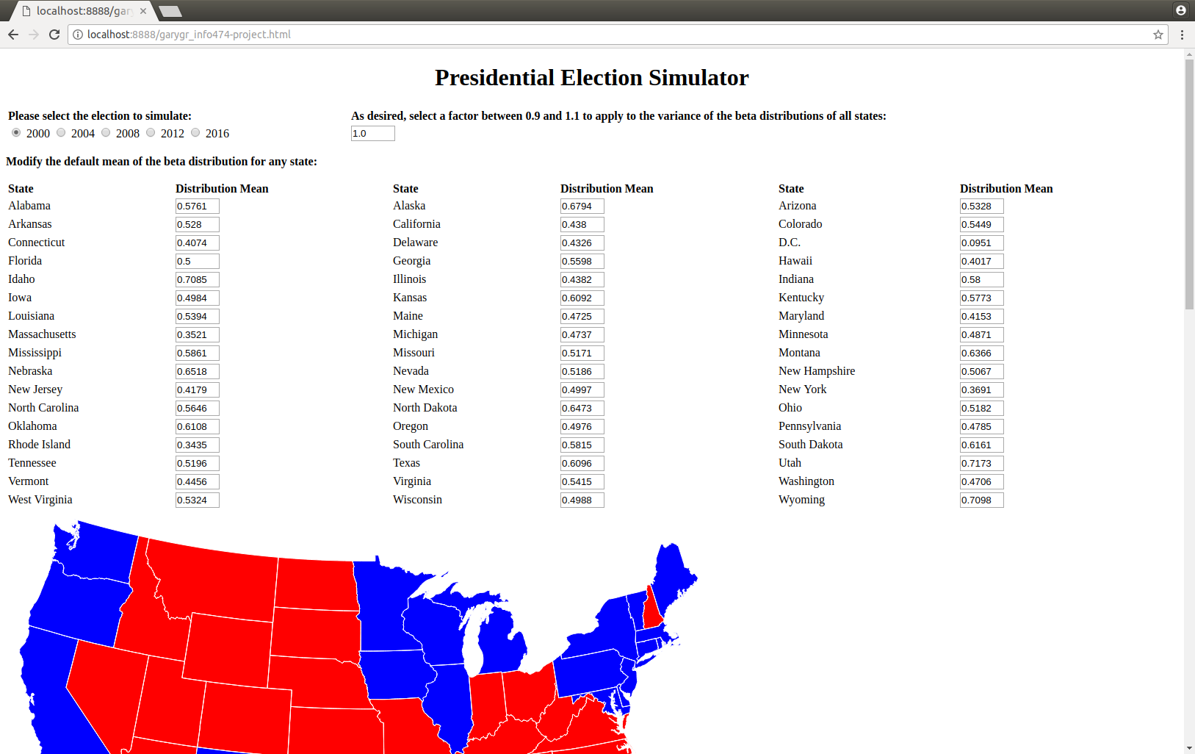
Demo Screenshot Upper

Slide 9
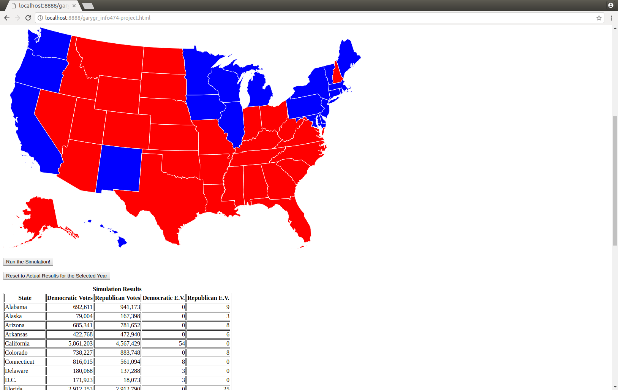
Demo Screenshot Lower

Slide 10
Timeline of Tasks
I worked alone on this project due to a large, concurrent collaborative project for another course
I used R and RStudio to help manage and auto generate CSV files, and painstakingly entered election results by hand from Wikipedia using their articles for the 2000 through 2016 elections
Limiting to major party candidates, I calculated results percentages for each state in each year
I calculated overall election variance for each state considering all five elections
I added each state’s electoral vote assignments for each election
I determined that Apache supplies a Java software package for the Beta distribution, integrated this, and wrote a sample Java interface for the simulation engine
I wrote the HTML and JavaScript code to present the interactive visualization you saw
Next: Write the Java simulation engine, and integrate it with the visualization

Slide 11
Limitations and Conclusion
The simulator does not consider third-party candidates
The simulator assumes winner-take-all electoral votes in Maine and Nebraska; the actual results presented for the 2008 and 2016 elections are therefore off by one electoral vote
Due to the above, simulation results will also be winner-take-all for Maine and Nebraska
Thank you! Are there any questions?

